Slide 1
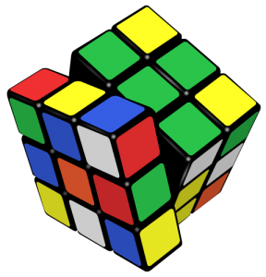

Problem Solving
How to solve problems
SoftUni Team
Technical Trainers
Sofware University
https://softuni.bg/

Slide 2
Questions?
sli.do
#TECH-FUND

Slide 3
Table of Content
What is a problem?
Stages of problem solving
Complexity of a problem
Example problems
From Chaotic to Methodological Approach

Slide 4

What is a problem
Current and Desired state diff

Slide 5

What is a Problem
Definition - A doubtful or difficult matter, requiring a solution
Goals - anything that you wish to achieve, where you want to be
Barriers - overcoming the barriers or obstacles that prevent the achievement of goals.
Without goals and barriers there is no problem

Slide 6

Stages
Stages of solving a problem

Slide 7
Solving a problem
Define the problem
Analyse the problem
Identify potential solutions
Evaluate and choose the best solution
Plan action
Implement and review results

Slide 8
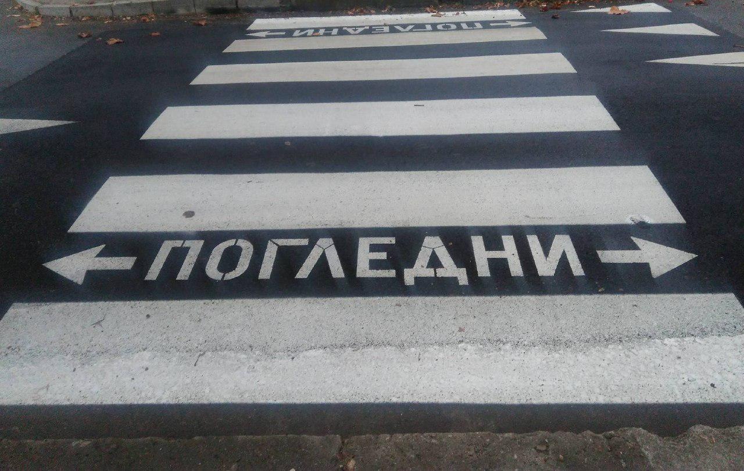
Problem Street Crossing
What are the steps to cross the street successfully ?

Slide 9
Problem Identification
Recognizing that there is a problem, identifying the nature of the problem, defining the problem.
Ascertain the objective of the decision maker
Understand the background of the problem
Isolate and identify the problem
Determine the unit of analysis and the relevant variables
State and research the objective

Slide 10

Structure of the Problem
Observation
Inspection
Fact-finding
Developing a clear picture of the problem.

Slide 11

Solutions and Decisions
Generating a range of possible courses of action and trying to evaluate them
Analyzing the different possible solutions and choosing the best one

Slide 12
Nine Dots Problem
Connect all of the nine dots, using only 4 lines.

Slide 13
Nine Dots Problem
Lets think outside the box!
What has changed?
Our point of view

Slide 14

Examples
Solving Problems

Slide 15
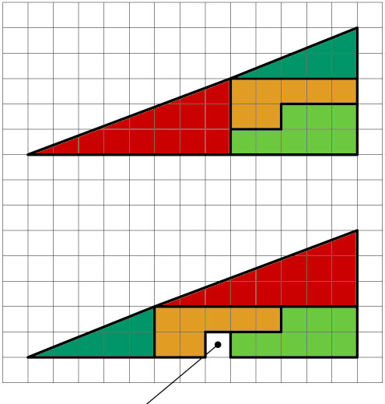
The Missing Piece

Slide 16
Five Gallons
You are mixing cement and the recipe calls for five gallons of water.
You have a garden hose giving you all the water you need.
The problem is that you only have a four gallon bucket and a seven gallon bucket and nether has graduation marks.
Find a method to measure five gallons.

Slide 17
The 100 Coins
There are 10 sets of 10 coins. You know how much the coins should weight.
You know all the coins in one set of ten are exactly a hundredth of an ounce off, making the entire set of ten coins a tenth of an ounce off.
You also know that all the other coins weight the correct amount.
You are allowed to use an extremely accurate digital weighing machine only once.
How do you determine which set of 10 coins is faulty?

Slide 18

Solutions

Slide 19
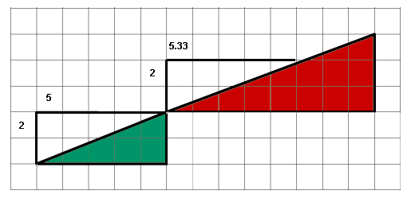
The Missing Piece
The gradient of the teal hypotenuse is different than the gradient of the red hypotenuse.

Slide 20
Five Gallons
Four gallon bucket -> Seven gallon bucket
Fill the four gallon bucket
Four gallon bucket -> Seven gallon bucket until full.
Empty the seven gallon bucket
One gallon bucket -> Seven gallon bucket.
Fill the four gallon bucket
Four gallons -> seven gallon

Slide 21
The 100 Coins
One coin from the first set is placed on the scale along with two from the second set etc...
If the weight is off by one hundredth of an ounce then it is the first set that is faulty
If the weight is off by two hundred of an ounce then it is the second set which is faulty, etc...

Slide 22
Solving
From Chaotic to Methodological Approach

Slide 23
Read and Analyze the Problems
Consider you are at a computer programming exam or contest
You have 5 problems to solve in 6 hours
First read carefully all problems and try to estimate how complex each of them is
Read the requirements, don't invent them!
Start solving the easiest / fastest to solve problem first!
Leave the most complex / slow to solve problem last!
Approach the next problem when the previous is well tested

Slide 24
Use a Sheet of Paper and a Pen
Never start solving a problem without a sheet of paper + a pen
You need to sketch your ideas
Paper and pen is the best visualization tool
Allows your brain to think efficiently
Paper works faster than keyboard / screen
Other visualization tools could also work well

Slide 25
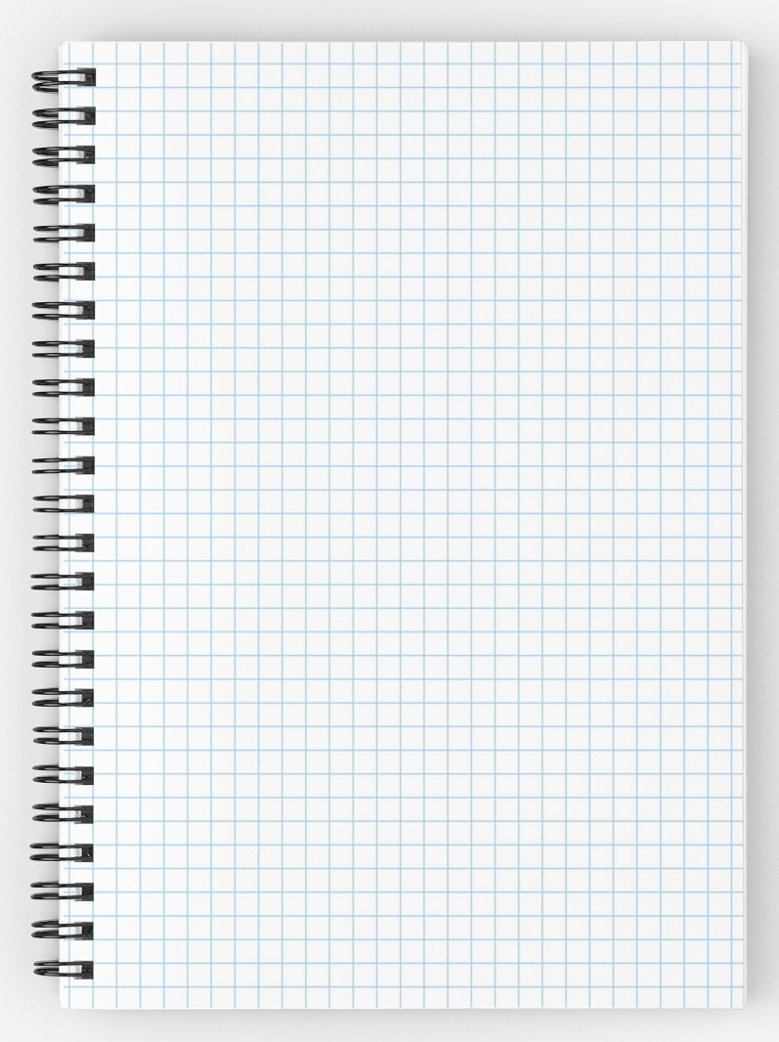
Prefer Squared Paper
Squared paper works best for algorithmic problems
Easy to draw a table
Easy to draw a coordinate system with objects at it
Easy to calculate distances
Easy to sketch a problem and solution idea

Slide 26
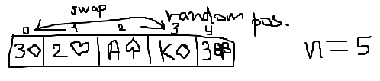
Paper and Pen
Consider a "Cards Shuffle" problem
We can sketch it to start thinking
Some ideas immediately come, e.g.
Split the deck into two parts and swap them a multiple times
Swap 2 random cards a random number of times
Swap each card with a random card

Slide 27
Invent Ideas
Think-up, Invent Ideas and Check Them

Slide 28
Think Up, Invent and Try Ideas
First take an example of the problem
Sketch it on the sheet of paper
Next try to invent some idea that works for your example
Check if your idea will work for other examples
Try to find a case that breaks your idea
Try challenging examples and unusual cases
If you find your idea incorrect, try to fix it
Or just invent a new idea

Slide 29
Think Up, Invent and Try Ideas
Idea #1: random number of times split the deck into left and right part and swap them
How to represent the cards?
How to chose a random split point?
How to perform the exchange?
Idea #2: swap each card with a random card
How many times to repeat this?
Is this fast enough?

Slide 30
Think Up, Invent and Try Ideas
Idea #3: swap 2 random cards a random number of times
How to choose two random cards?
How many times to repeat this?
Idea #4: choose a random card and insert it in front of the deck
How to choose random card?
How many times to repeat this?
Idea #5: do you have another idea?

Slide 31
Divide and Conquer
Decompose Problems into Manageable Pieces

Slide 32
Decompose the Problem
Work decomposition is natural in engineering
It happens every day in the industry
Projects are decomposed into subprojects
Complex problems could be decomposed into several smaller sub-problems
Technique known as "Divide and Conquer"
Small problems could easily be solved
Smaller sub-problems could be further decomposed as well

Slide 33
Divide and Conquer – Example
Let's try idea #1:
Split the deck into left and right part and swap them (many times)
Divide and conquer
Sub-problem #1 (single exchange) – split the deck into two random parts and exchange them
Sub-problem #2 – choosing a random split point
Sub-problem #3 – combining single exchanges
How many times to perform "single exchange"?

Slide 34
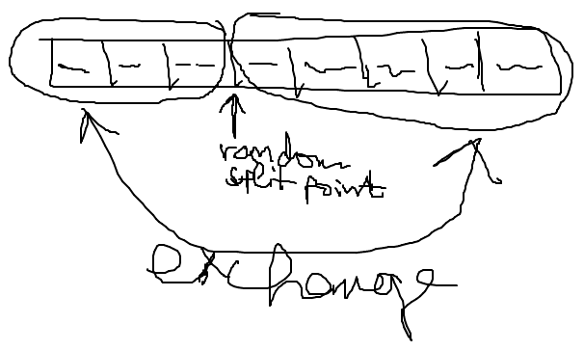
Sub-Problem #1 (Single Exchange)
Split the deck into two parts at random split point
And exchange these 2 parts
We visualize this by paper and pen:

Slide 35
Sub-Problem #2 (Single Exchange)
Choosing a random split point
Need to understand the concept of pseudo-random numbers and how to use it
In Internet lots of examples are available, some of them incorrect
The class System.Random can do the job
Important detail is that the Random class should be instantiated only once
Not at each random number generation

Slide 36
Sub-Problem #3 (Single Exchange)
Combining a sequence of single exchanges to solve the initial problem
How many times to perform single exchanges to reliably randomize the deck?
N times (where N is the number of the cards) seems enough
We have an algorithm:
N times split at random position and exchange the left and right parts of the deck

Slide 37
Check-up Your Ideas
Don't go Ahead before Checking Your Ideas

Slide 38
Check-up Your Ideas
Check-up your ideas with examples
It is better to find a problem before the idea is implemented
When the code is written, changing your ideas radically costs a lot of time and effort
Carefully select examples for check-up
Examples should be simple enough to be checked by hand in a minute
Examples should be complex enough to cover the most general case, not just an isolated case

Slide 39
Check-up Your Ideas – Example
Let's check the idea:
After 3 random splits and swaps we obtain the start position
Seems like a serious problem!

Slide 40
Invent New Idea If Needed
What to do when you find your idea is not working in all cases?
Try to fix your idea
Sometimes a small change could fix the problem
Invent new idea and carefully check it
Iterate
Usually your first idea is not the best
Invent ideas, check them, try various cases, find problems, fix them, invent better ideas, etc.

Slide 41
Invent New Ideas – Example
Invent a few new ideas:
New idea #1 – multiple times select 2 random cards and exchange them
New idea #2 – multiple times select a random card and exchange it with the first card
New idea #3 – multiple times select a random card and move it to an external list
Let's check the new idea #2
Is it correct?

Slide 42
Check-up the New Idea – Example

Slide 43
Implementation
Coding and Testing Step-by-Step

Slide 44
Start Coding: Check List
Never start coding before you find a correct idea that will meet the requirements
What shall you write before you have a correct idea?
Checklist to follow before start of coding:
Ensure you understand the requirements well
Ensure you have come up a good idea
Ensure your idea is correct
Ensure you know what data structures to use
Ensure the performance will be sufficient

Slide 45
Implement your Algorithm Step-by-Step
"Step-by-step" approach is always better than "build all, then test"
Implement a piece of your program and test it
Then implement another piece of the program and test it
Finally put together all pieces and test it
Small increments (steps) reveal errors early
"Big bang" integration takes more time

Slide 46
Testing the Code
Thoroughly Test Your Solution

Slide 47
Thoroughly Test your Solution
Wise software engineers say that:
Inventing a good idea and implementing it is half of the solution
Testing is the second half of the solution
Always test thoroughly your solution
Invest in testing!
One 90-100% solved problem could be better than 2 or 3 partially solved
Testing an existing problem takes less time than solving another problem from scratch

Slide 48
How to Test?
Testing could not certify absence of defects
It just reduces the defects’ rates
Well tested solutions are more likely to be correct
Start testing with a good representative of the general case
Not a small isolated case
A typical case
Large enough test case, but
Small enough to be easily checkable

Slide 49
Read the Problem Statement
Read carefully the problem statement
Does your solution print exactly what is expected?
Does your output follow the requested format?
Did you remove your debug printouts?
Be sure to solve the requested problem, not the problem you think is requested!
Example: "Write a program to print the number of permutations of n elements" means to print a single number, not a set of permutations!

Slide 50

Summary
Problem solving needs methodology:
Understanding and analyzing problems
Using a sheet of paper and a pen for sketching
Thinking up, inventing and trying ideas
Decomposing problems into sub-problems
Selecting appropriate data structures
Thinking about the efficiency and performance
Implementing step-by-step
Testing the nominal case, border cases and efficiency
…
…
…

Slide 51
https://softuni.bg/trainings/courses

Slide 52













SoftUni Diamond Partners

Slide 53





SoftUni Organizational Partners

Slide 54




Trainings @ Software University (SoftUni)
Software University – High-Quality Education and Employment Opportunities
softuni.bg
Software University Foundation
http://softuni.foundation/
Software University @ Facebook
facebook.com/SoftwareUniversity
Software University Forums
forum.softuni.bg

Slide 55

License
This course (slides, examples, demos, videos, homework, etc.) is licensed under the "Creative Commons Attribution-NonCommercial-ShareAlike 4.0 International" license

